Slide 1



Across cultures 3: People we admire
Part 1

Slide 2
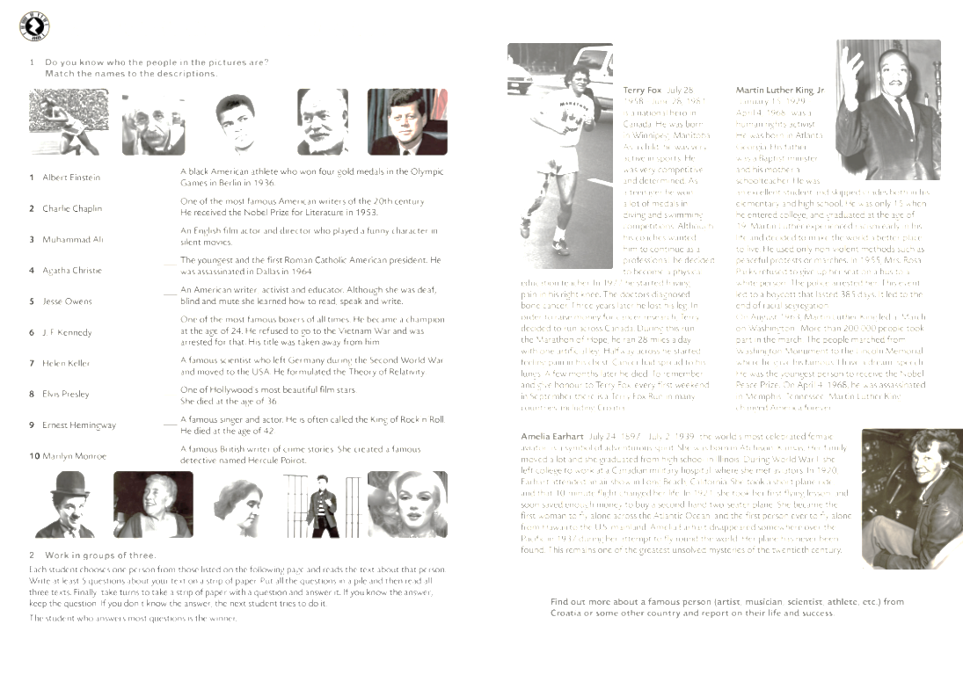



Slide 3

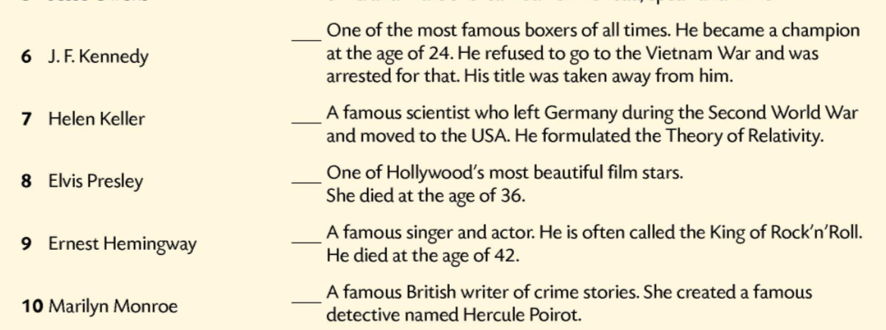
5
9
2
6
7
3
1
10
8
4

Slide 4


Slide 5
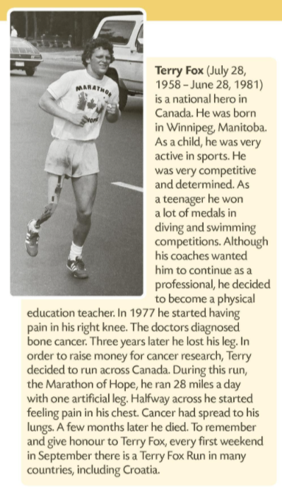
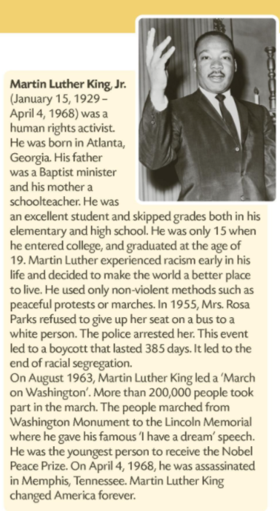

Slide 6



